Slide 1
4-H Photovoice: How to Reduce Stress
Abby Bowers and Margaret Wozniak

Slide 2
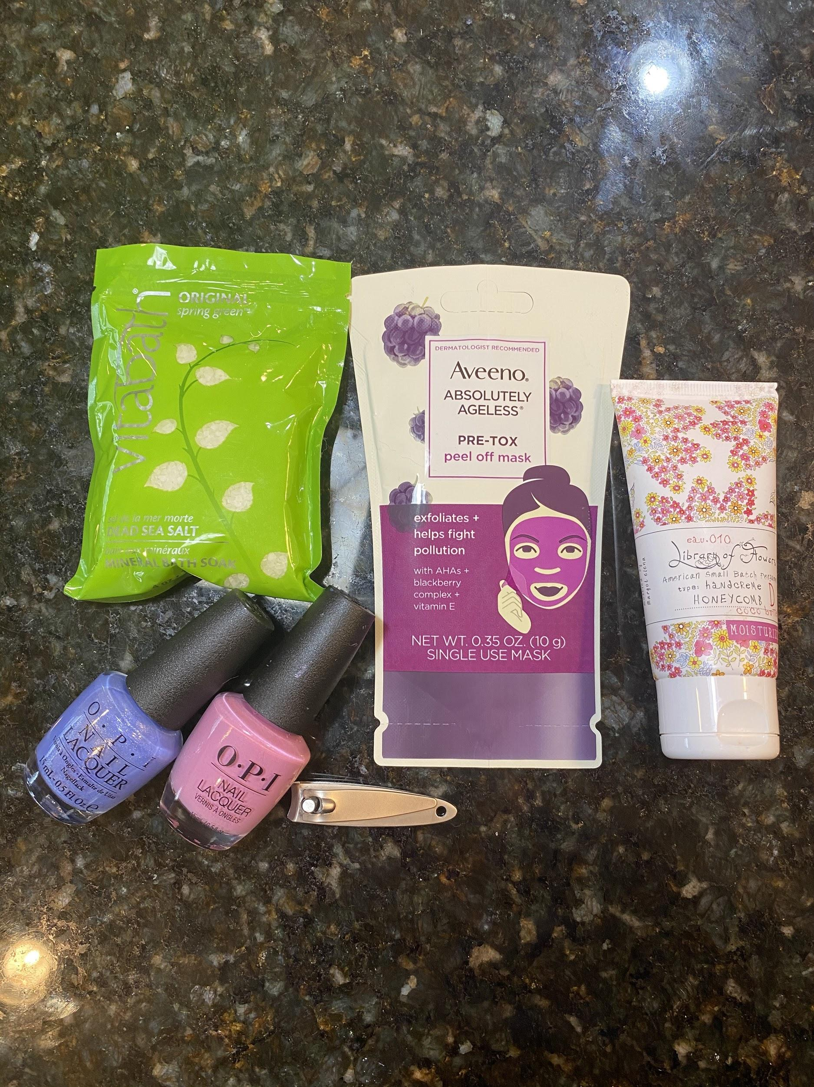
Take a self care day! Indulge yourself by putting on a face mask, painting your nails, and taking it easy. A self care day can be very stress relieving.

Slide 3
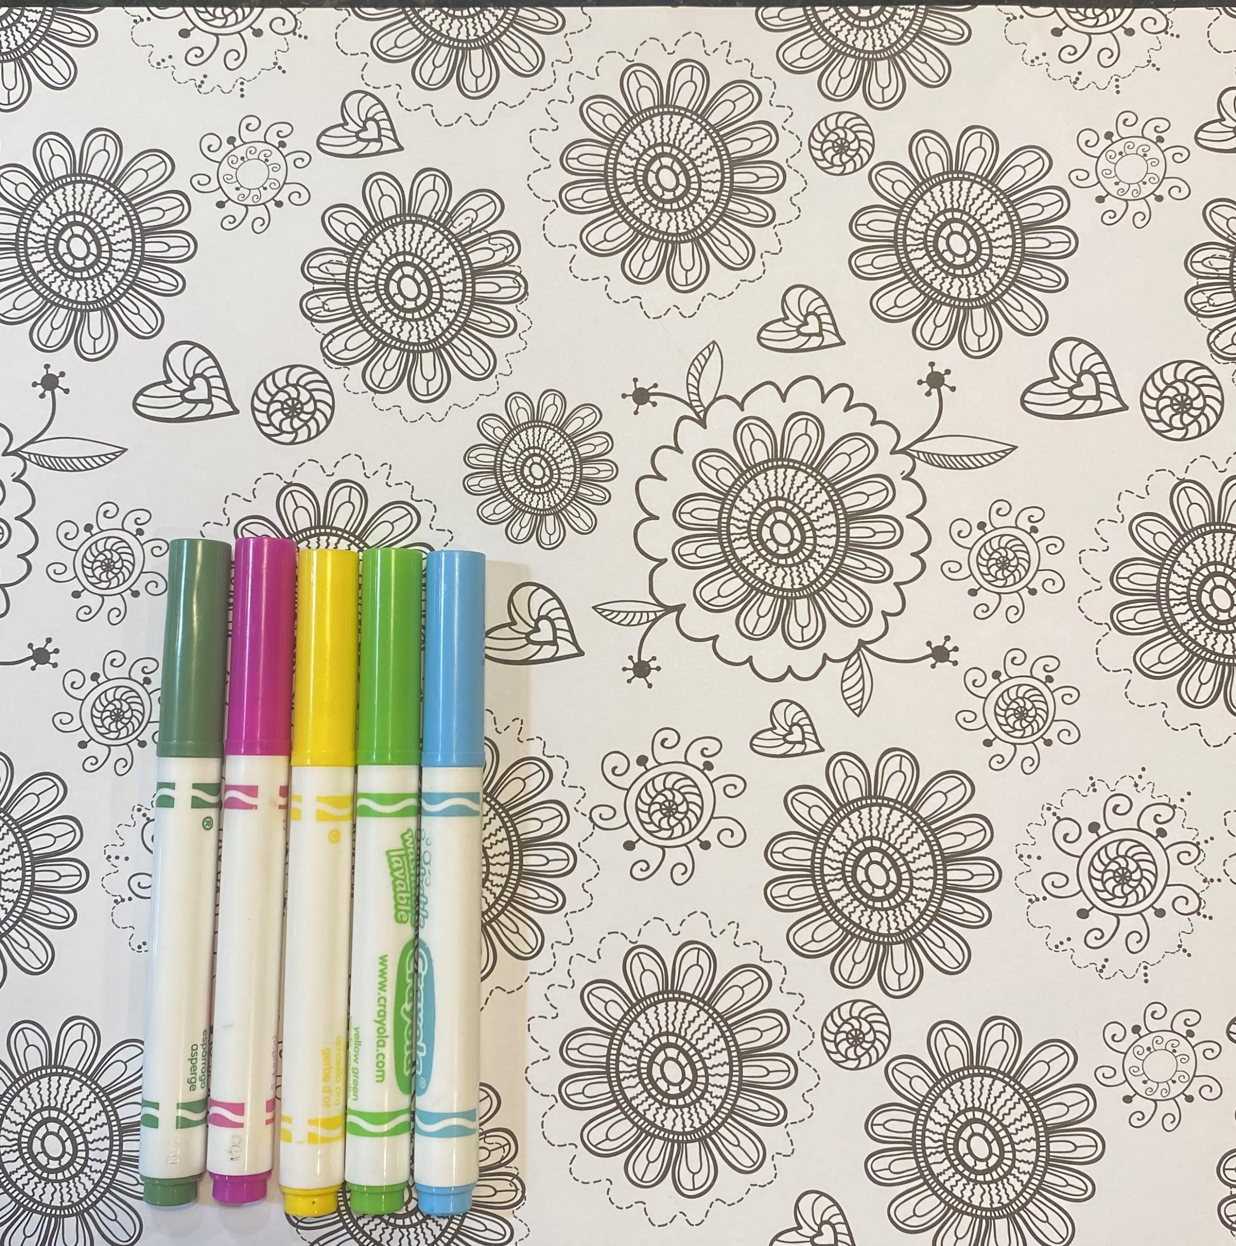
If you want to clear your mind, try coloring! Coloring can reduce stress and anxiety levels. Also, when you’re finished you will have a pretty picture to look at!

Slide 4
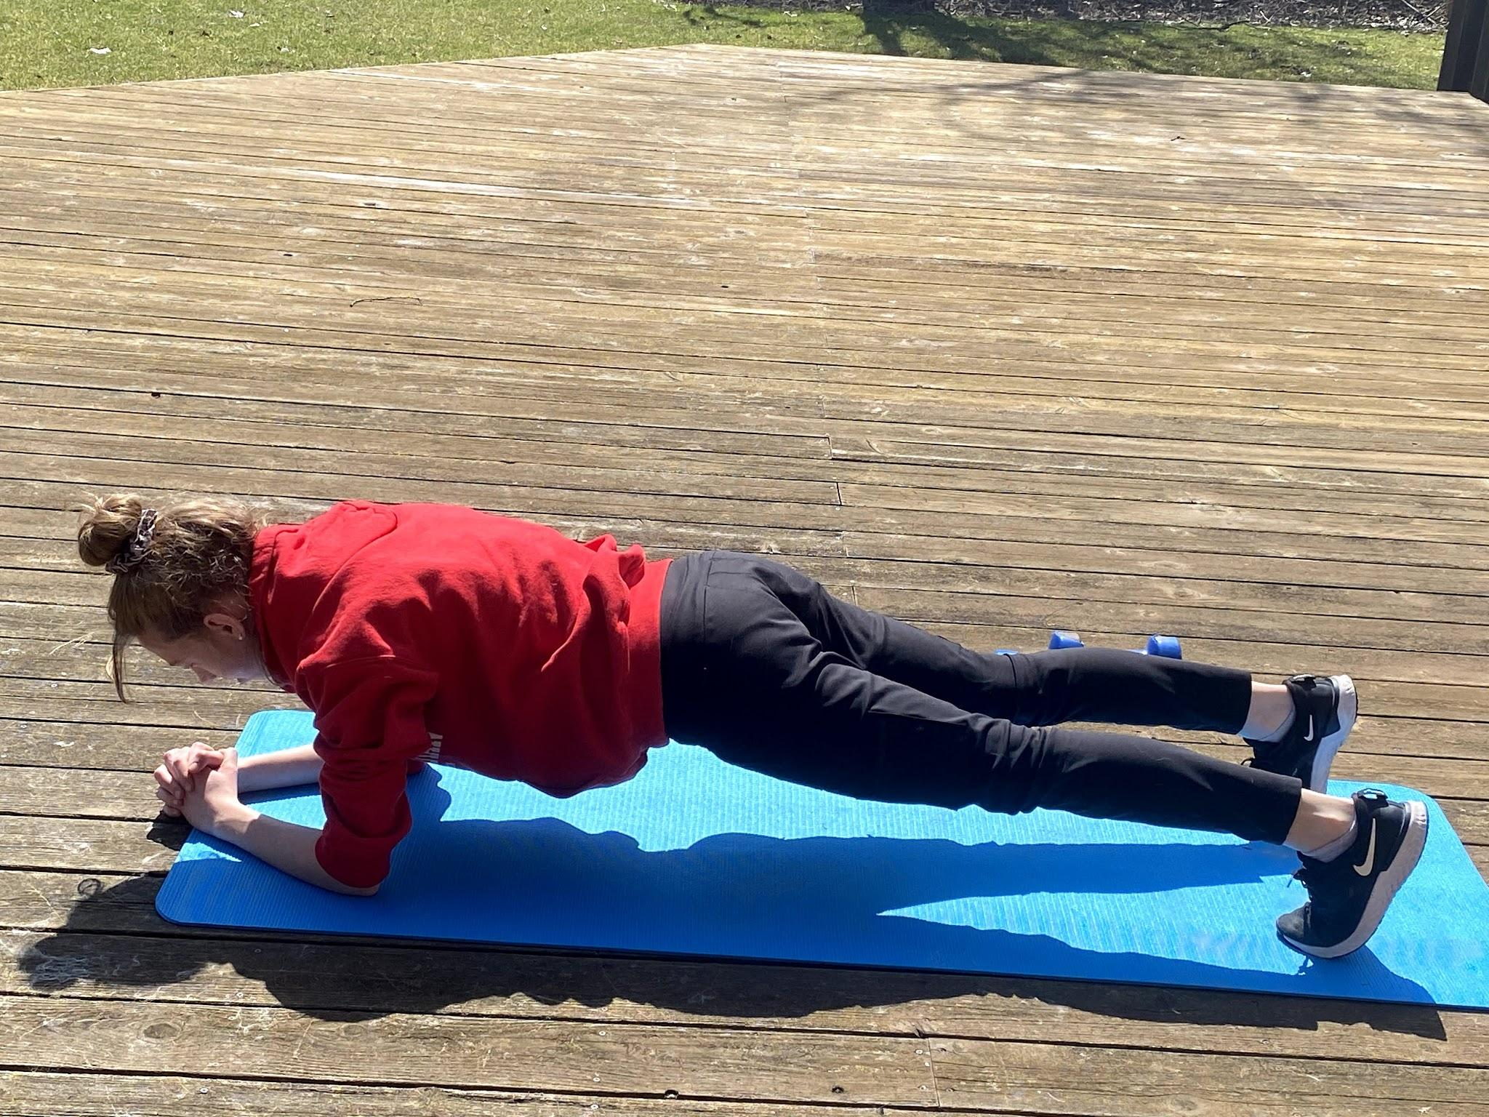
Exercising can also reduce stress. Exercise produces endorphins and improves the ability to sleep which in turn, reduces stress.

Slide 5
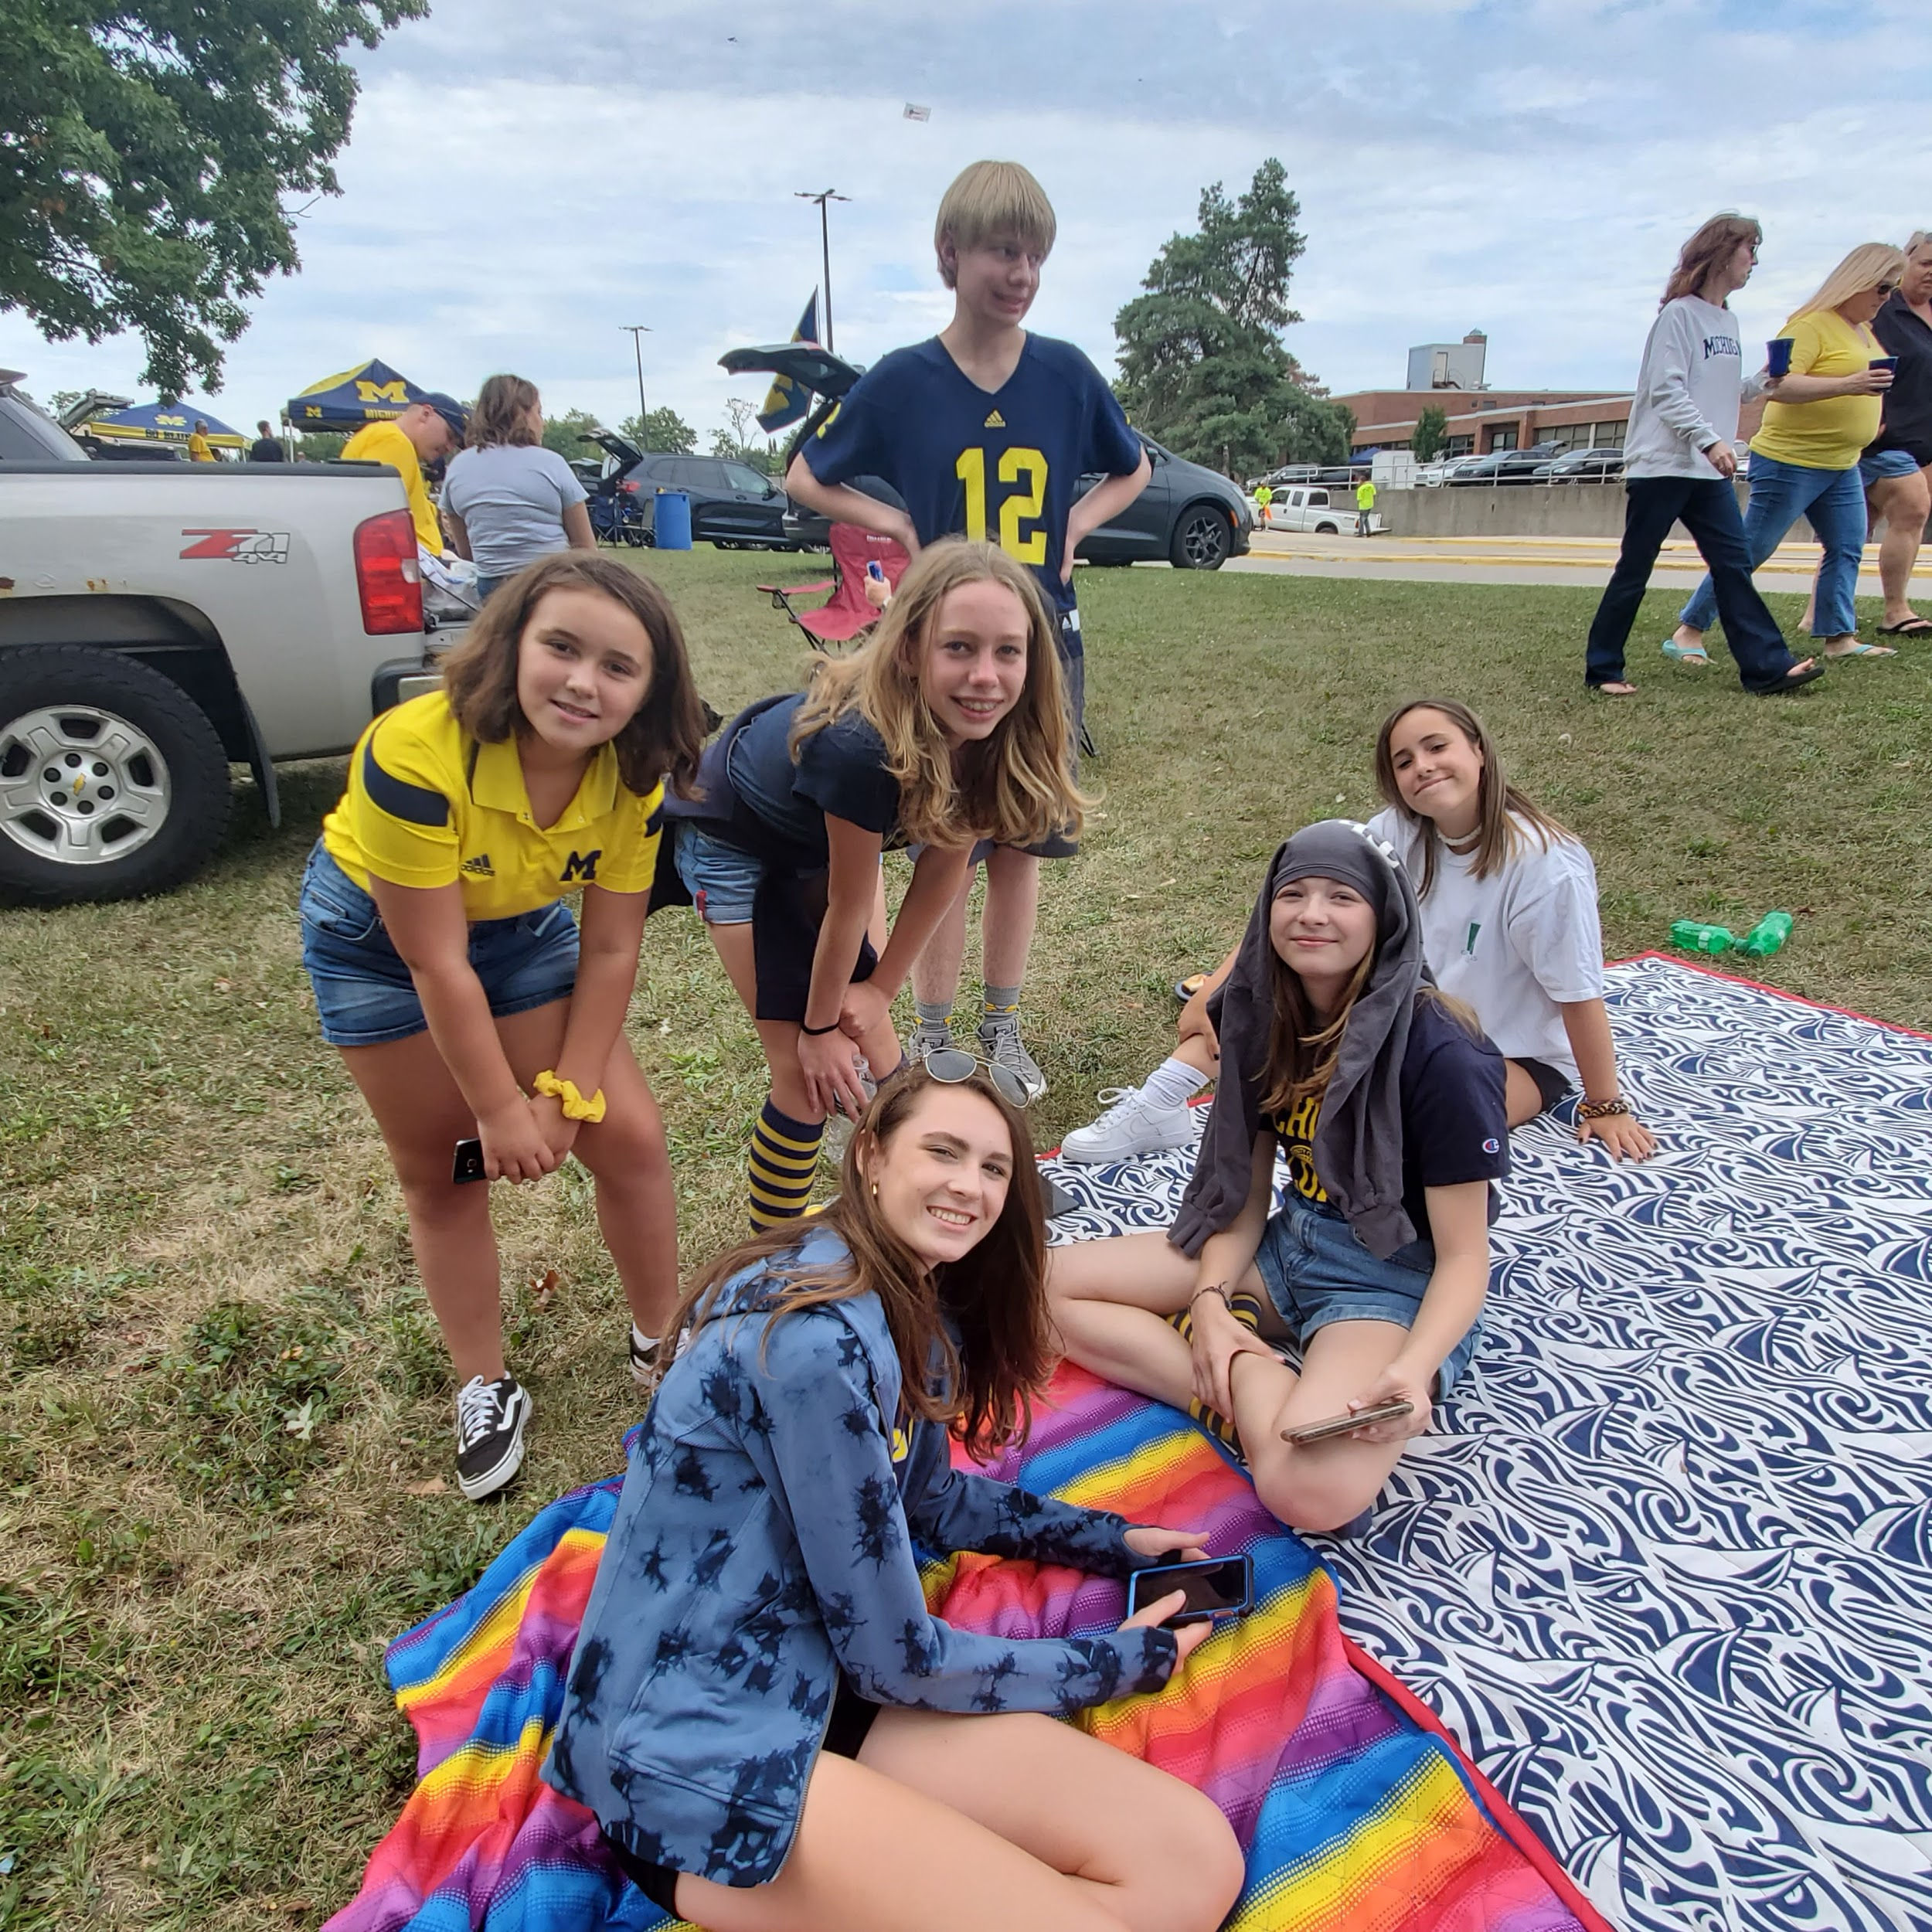
Reach out to a friend! Having a companion can help you take your mind off things. Hanging out with a friend reduces cortisol (the stress hormone). People release more endorphins (happy hormones) when they are in a social setting. Friends are always there to lend a hand or an ear when you need it. Some of the best memories you can have are the ones you make with them. Everything you do with them can feel just 100 times better.

Slide 6
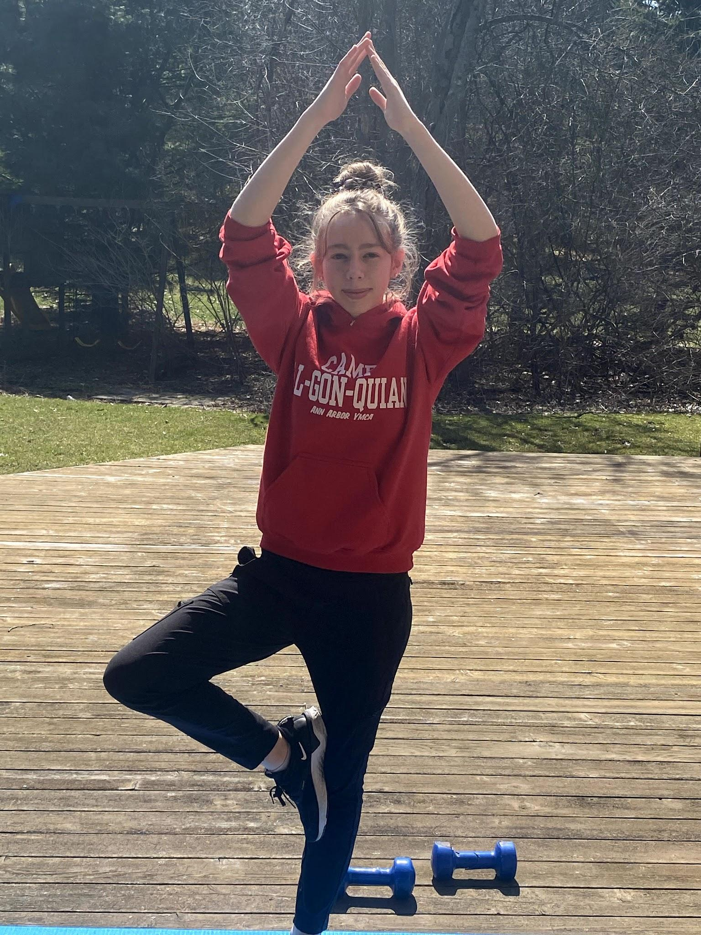
Doing yoga could help you take your mind off things. Yoga is great for the mind, body, and soul. Strike a pose!

Slide 7
Try spending some time in nature! Looking at the water, watching a bird, and other activities in nature, can be very calming and peaceful. Observing nature can also give you some time to think about things and focus on your own mental health.

Slide 8
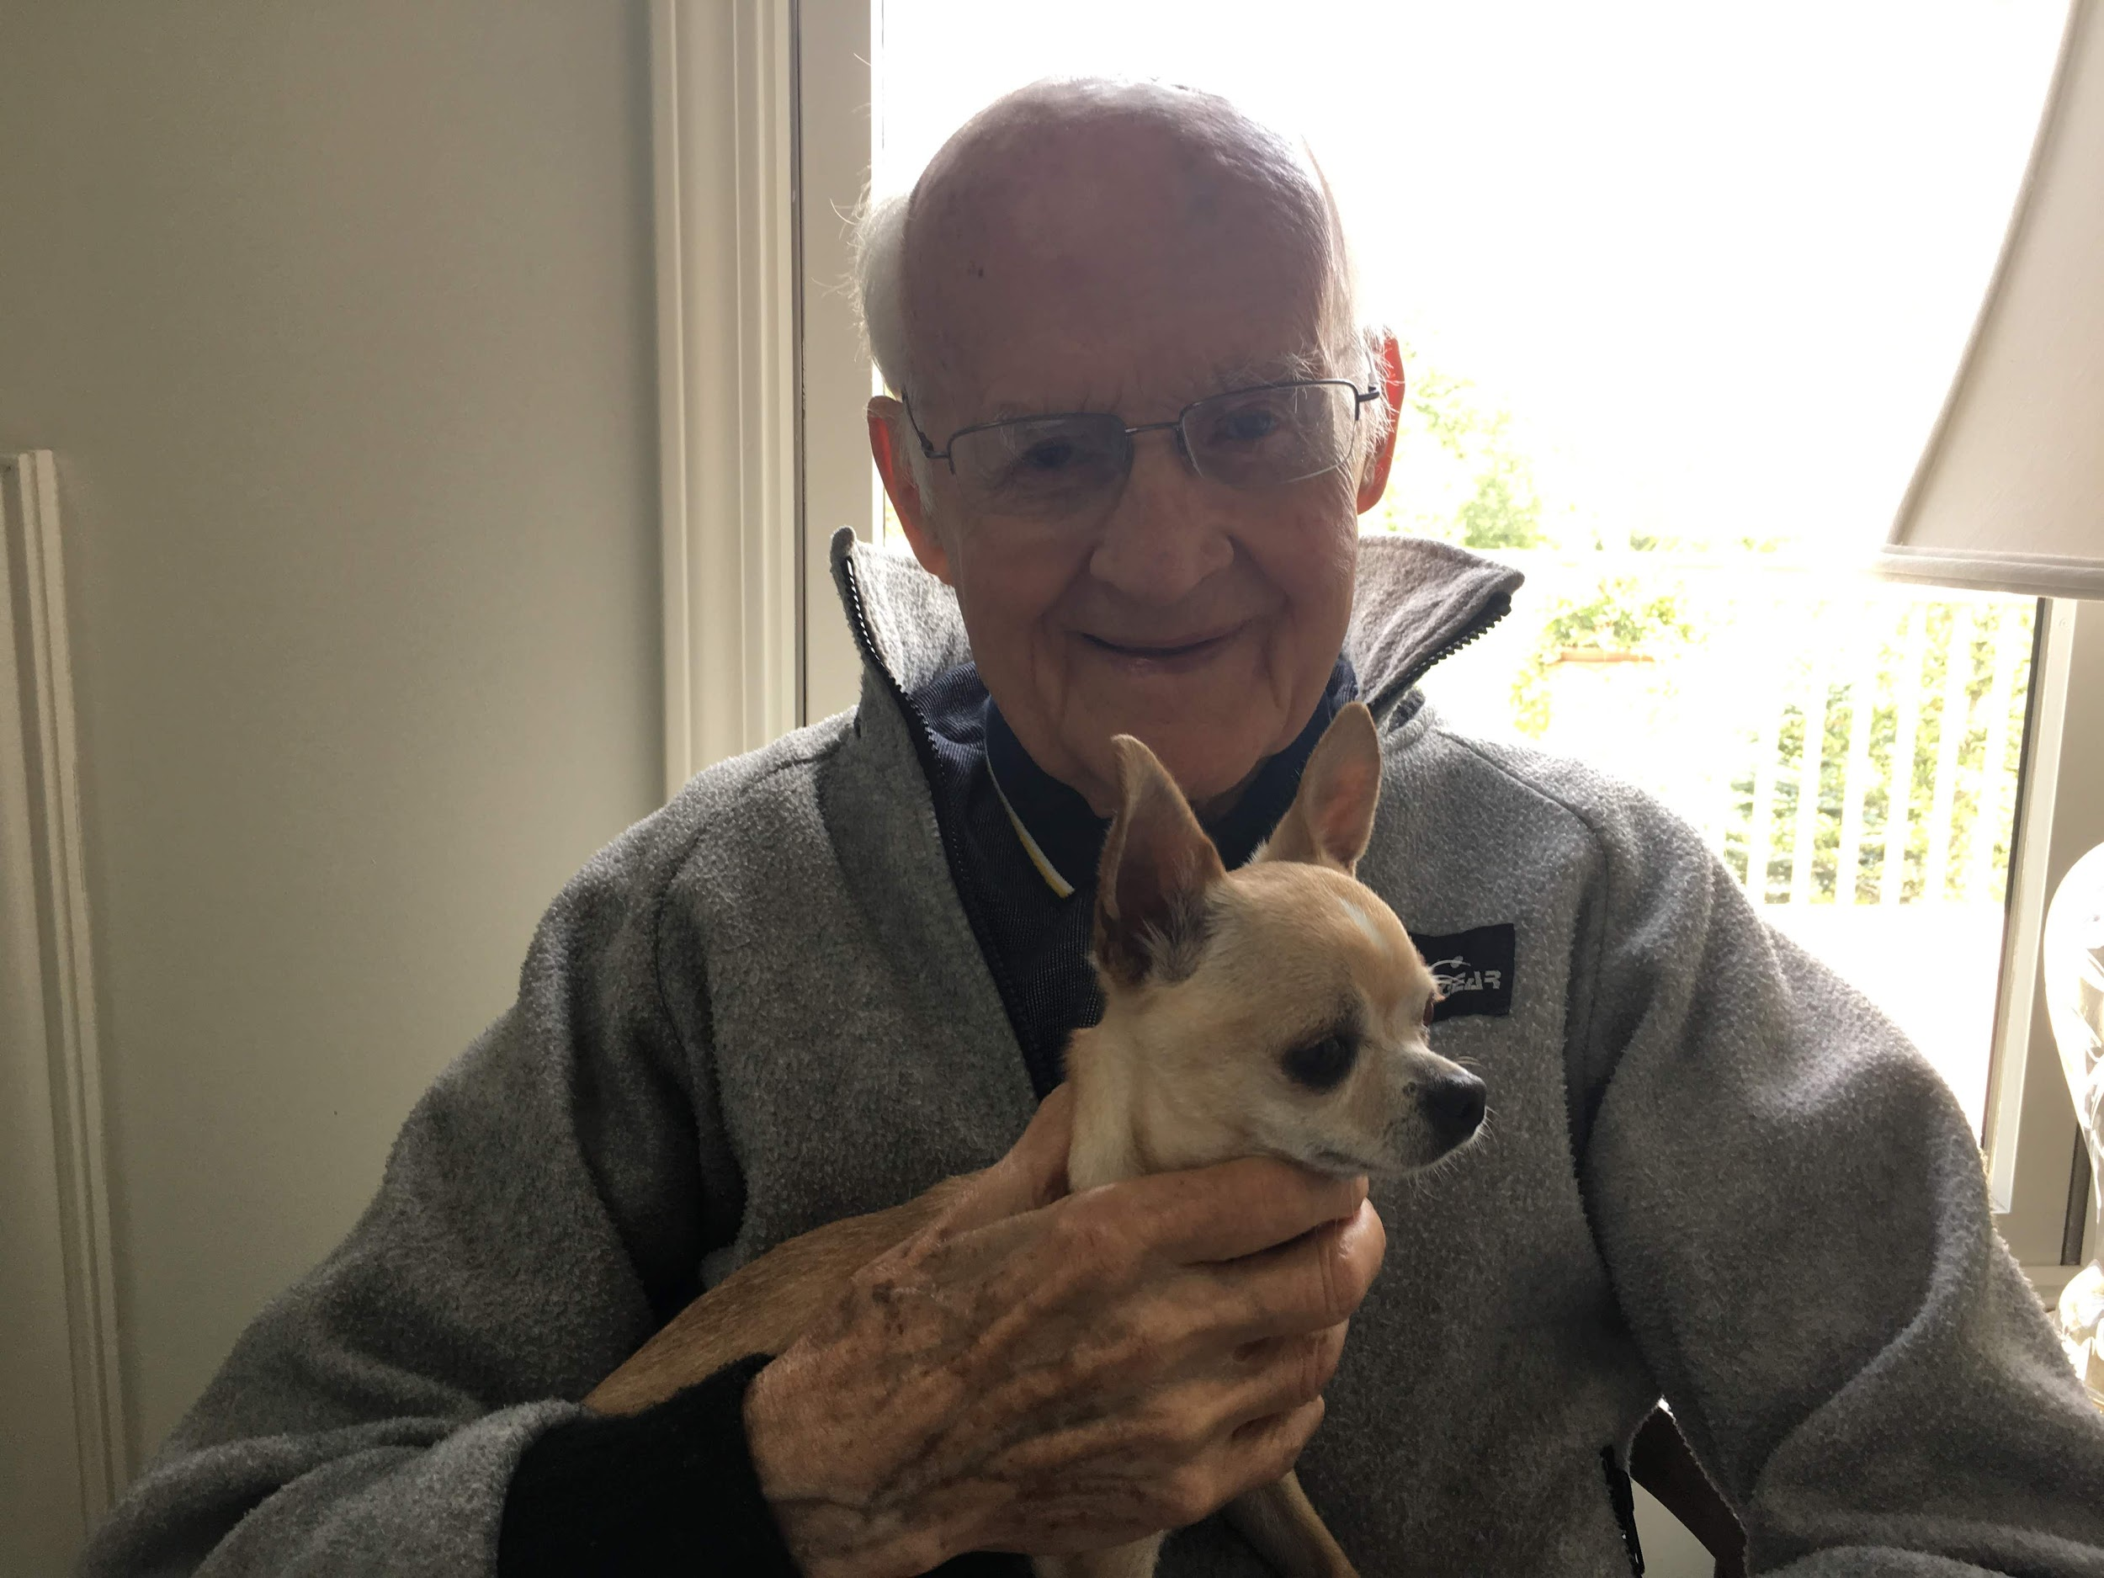
Spend some time with your family! Talking to a family member about stressful situations can be very beneficial. It is good to find someone who will listen you and be understanding when you are feeling stressed out.

Slide 9
Getting outside can bring you some peace. Being able to smell the grass and see the vivid blue sky takes your mind of of things faster than you might think. Look for the birds and how they fly in the windy sky. See the colors around you and how the little bees fly around flowers. Take a good look around you, you might be surprised by what you see.

Slide 10
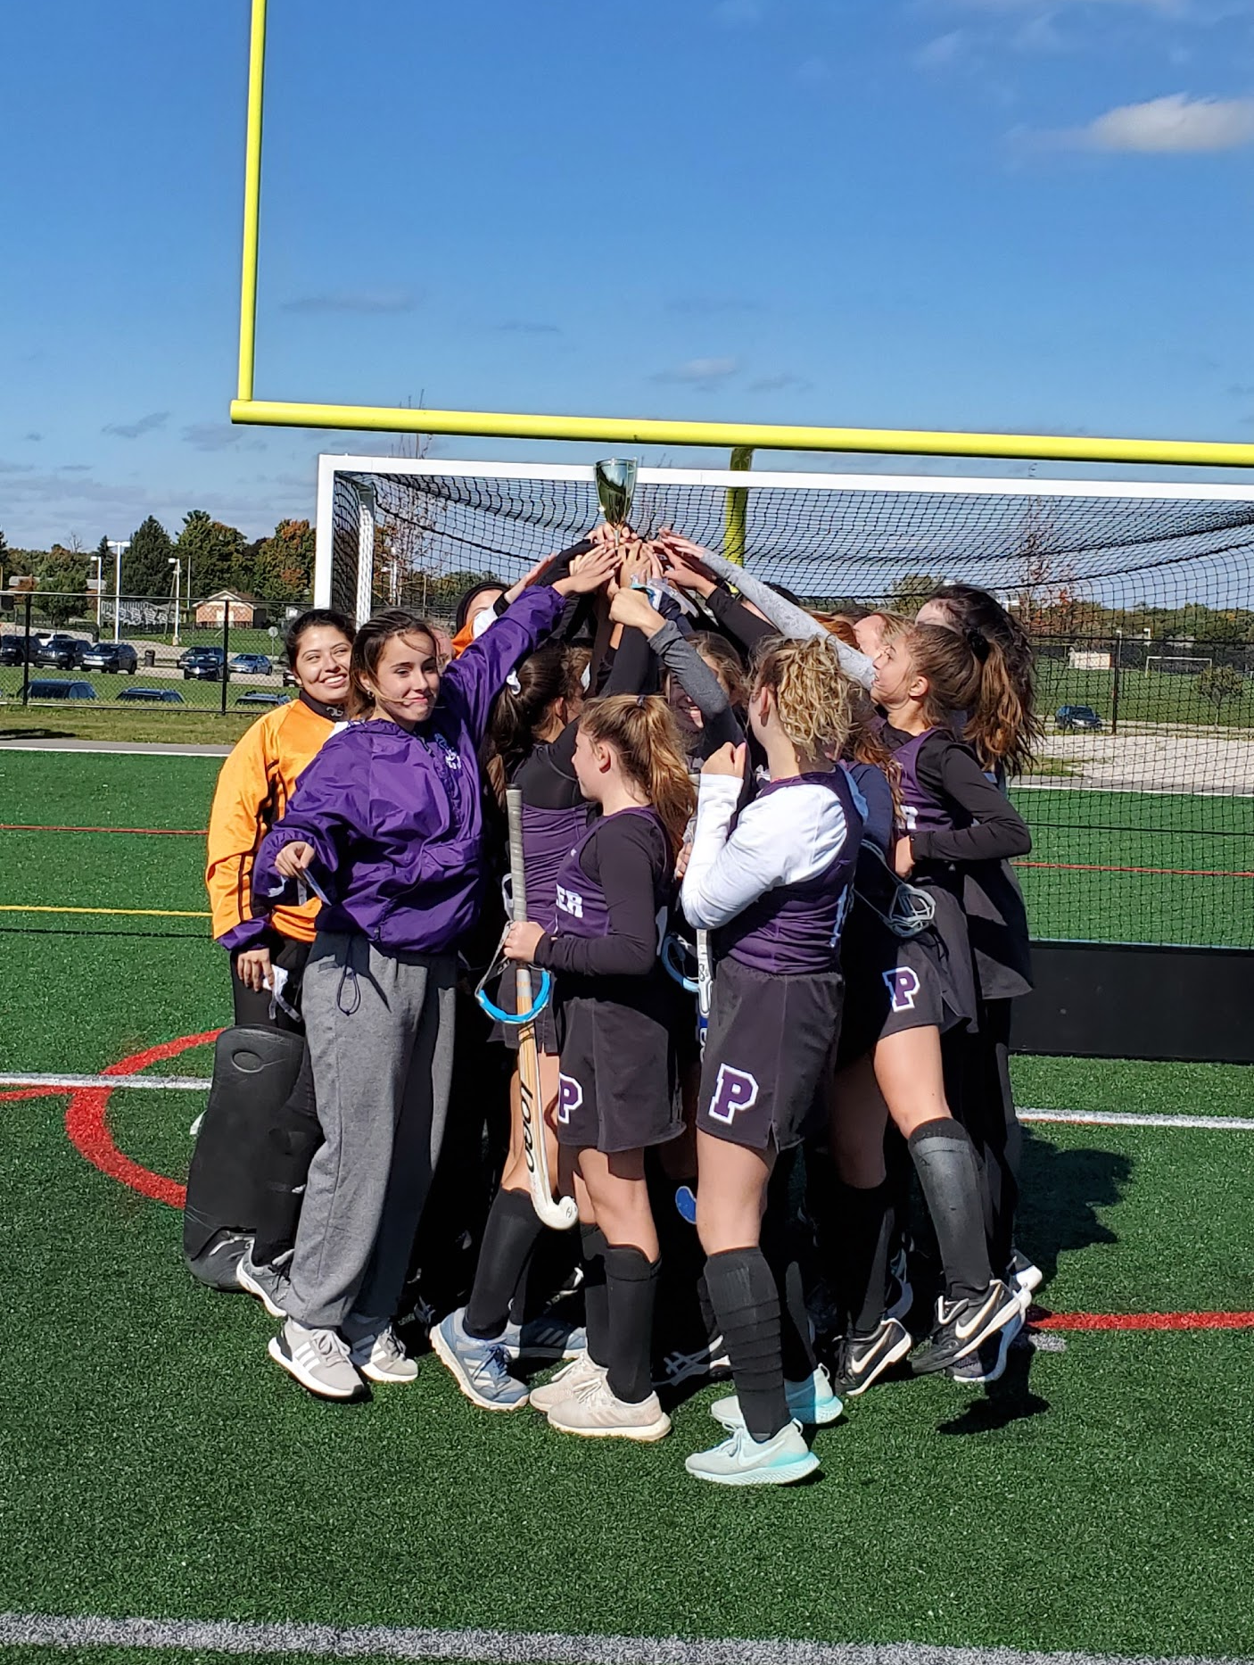
Join a sport or a team. Teams are a great way to gain friends and a support network for when you are stressed or feel out of it. Your teammates can be one of the best places to go if you need to talk. The physical activity from the sport can also be very beneficial for your health. Not to mention the absolute elation you can feel when you win a game or score a goal. Even the downs have their benefits, as you “have to lose to know how to win-Aerosmith”.

Slide 11
Having and/or making food can be a great stress reliever. When you are making food it can be frustrating, but the pride you feel when you are done is worth it. Even something as simple as eating can take your mind of of things. Focus on the flavors, the textures, let them take your mind off of things.

Slide 12
Listening to music can be a great way for you to destress. Depending on your mood, focus on the lyrics, the melody, or both. Trying to focus on the lyrics can be grounding. Listening to melody can be a great way to just simply let go of your problems with the changes in the sounds.

Slide 13
Having a pet is a great for reducing stress. Pets are great listeners if you need an ear that won’t offer an opinion. They can be a good source of comfort when you pet them and lay with them. They can be an outlet for energy when you play with them or walk them.

Slide 14
The 4HChangemakers is a group of Washtenaw County students (ages 13-18) whose goal is to raise student awareness and help educate their peers about what they can do (for themselves and others) regarding youth mental health in their communities. The students have hosted education/outreach events and trainings.
Teens use digital storytelling to increase awareness and destigmatize mental health through social media and (now virtual) public exhibits. Local and online experts share knowledge of tools to help tell stories: photography, graphic arts, videography, podcasting, interview techniques, meme making, and more. The group continues to explore innovative ways to humanize stories and share information with their peers.
This 4H Changemakers 2020 Digital Exhibit – STOMP OUT STIGMA -
is made possible thanks to generous funding from 4H, Microsoft, and University of Michigan Community Health Services.
Contact Washtenaw County 4H for more information about this and other teen mental health initiatives at (734) 222-3900 https://www.canr.msu.edu/washtenaw/washtenaw_county_4_h/

